Slide 1
Attendance Management System

Slide 2
Python and MySQL
Objective: To develop a simple and efficient system for managing attendance records using Python and MySQL.
Technologies Used:
Python: Backend logic
MySQL: Database for storing attendance data
CSV: Exporting attendance reports
Key Features: ✅ Insert new attendance records ✅ View all records ✅ Update attendance status ✅ Delete records ✅ Export data to CSV

Slide 3
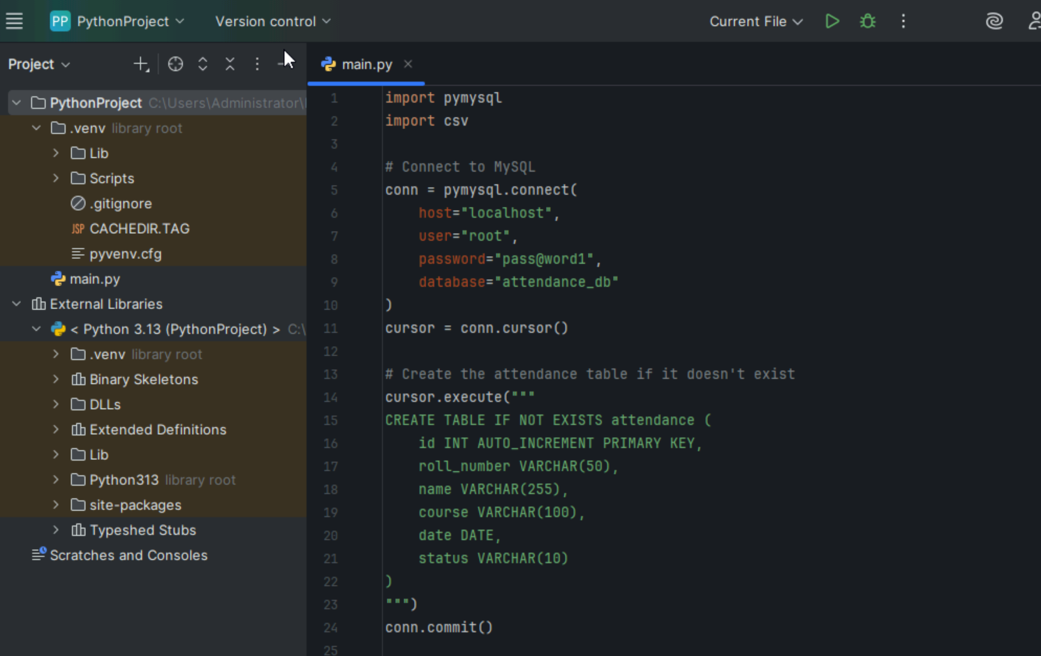
Code

Slide 4
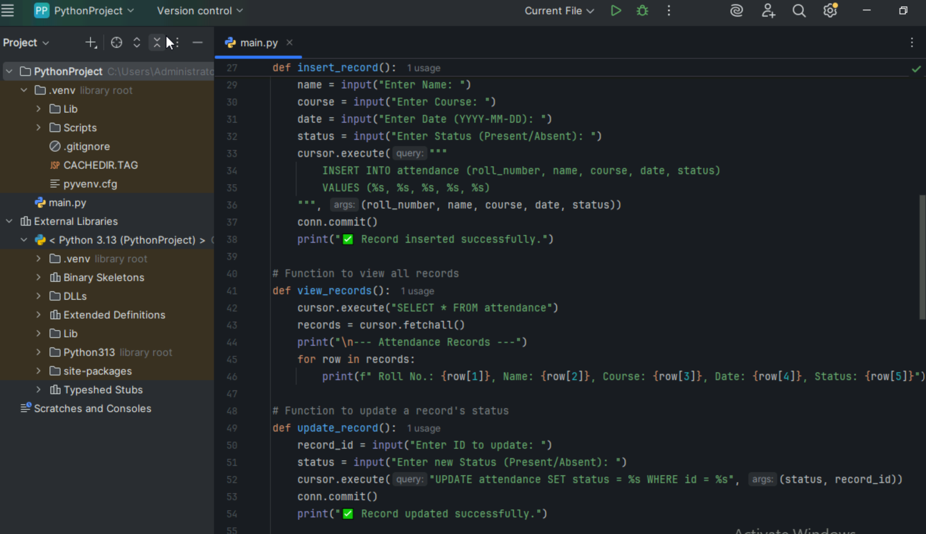

Slide 5
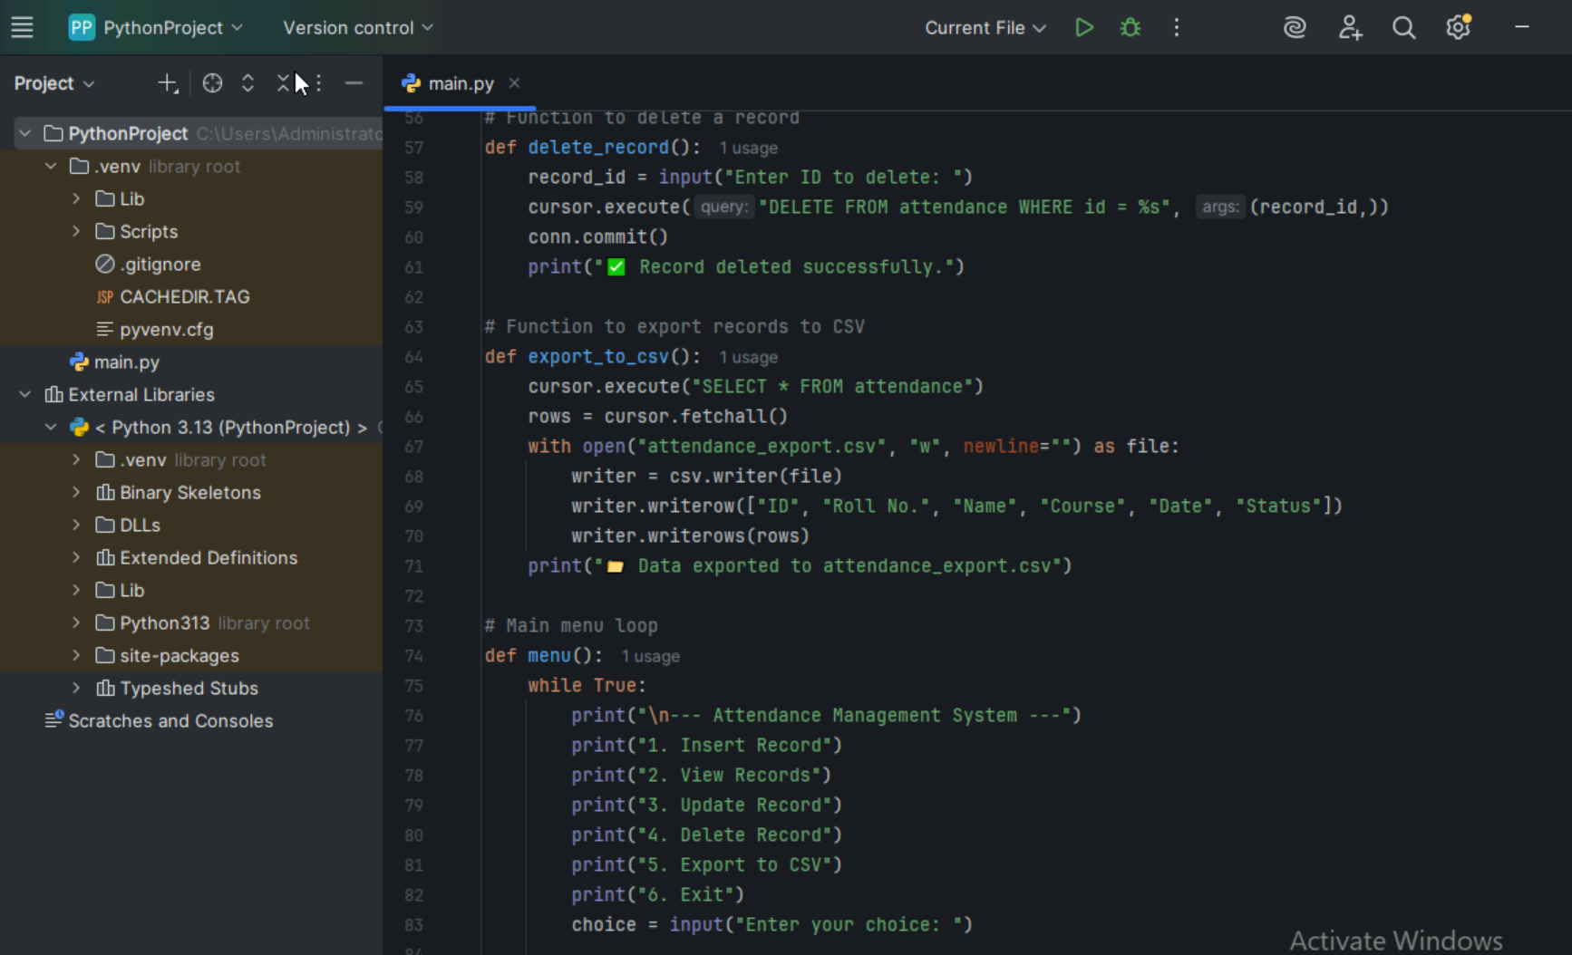

Slide 6
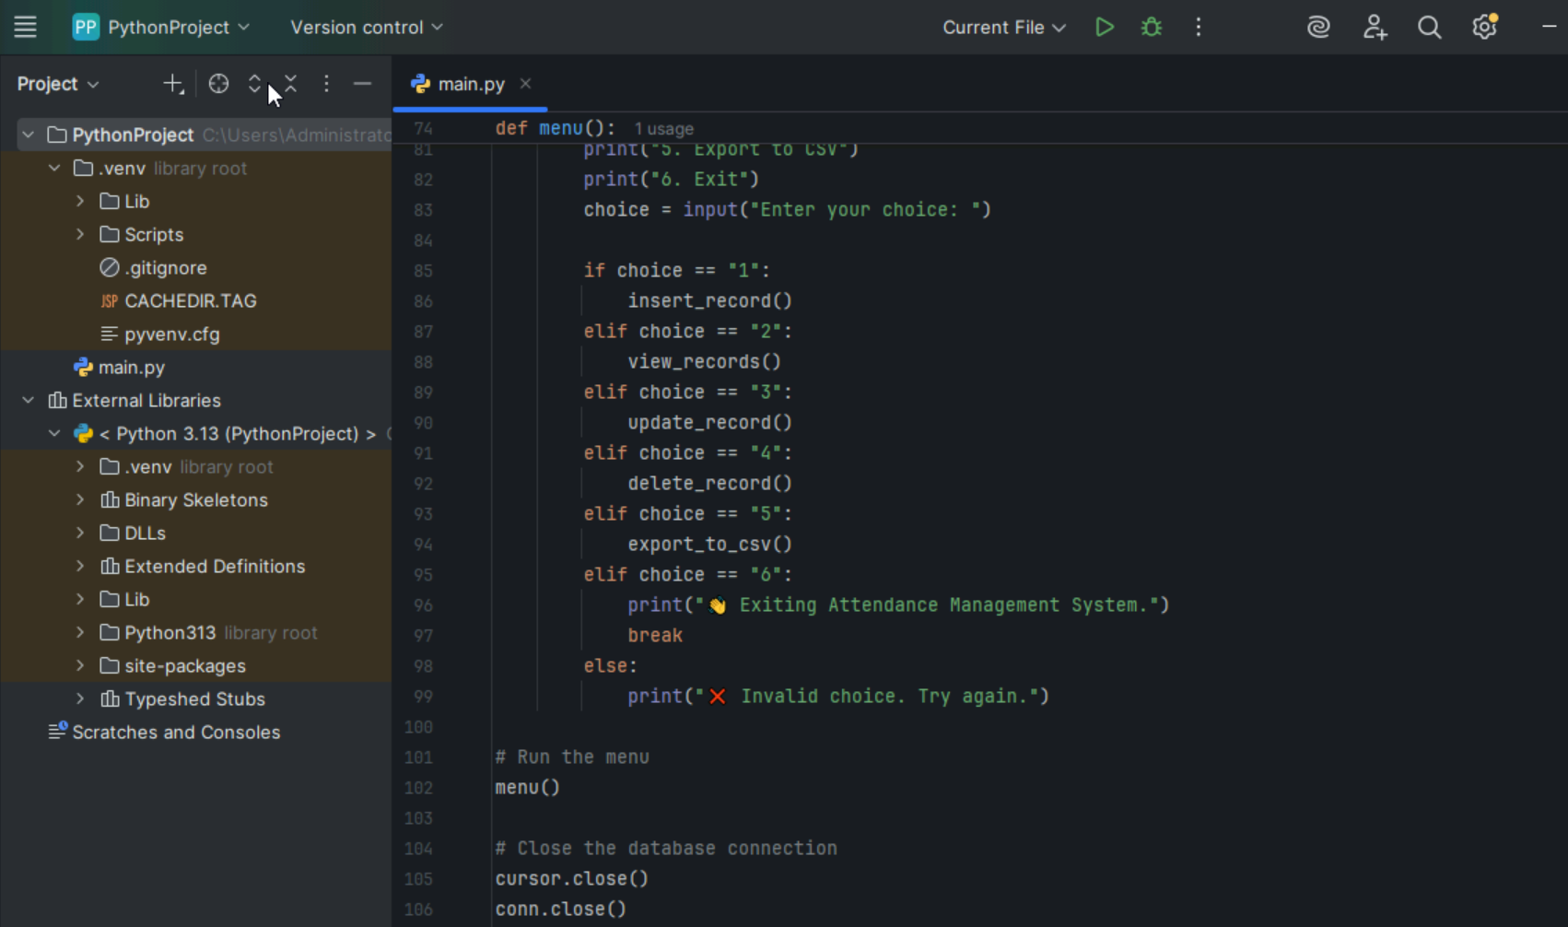

Slide 7
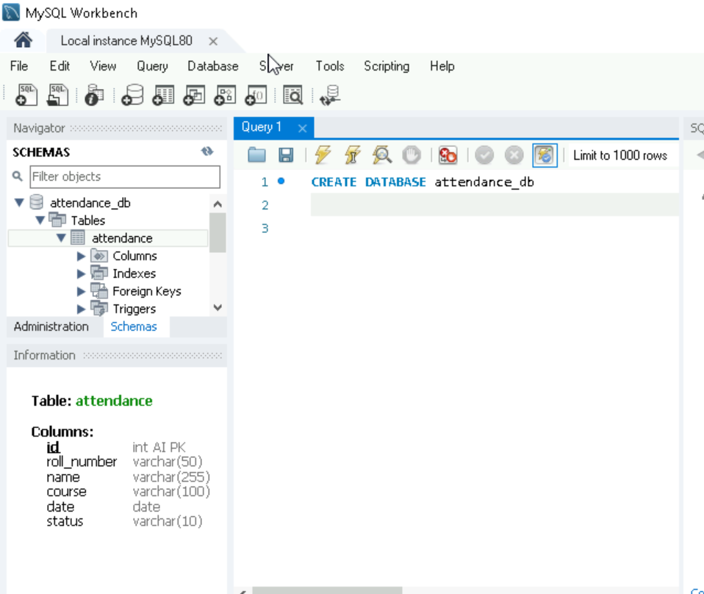
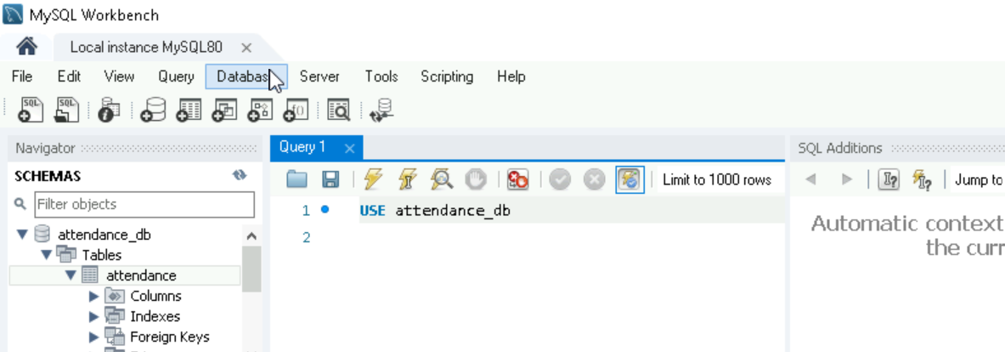
My sql workbench

Slide 8
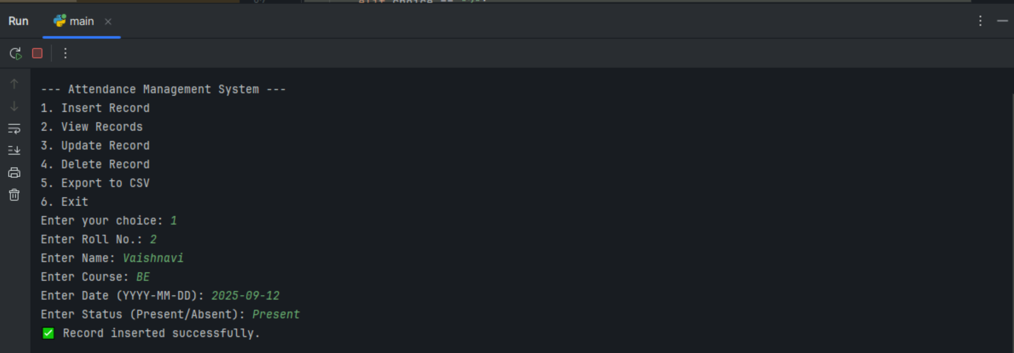
Insert Record

Slide 9
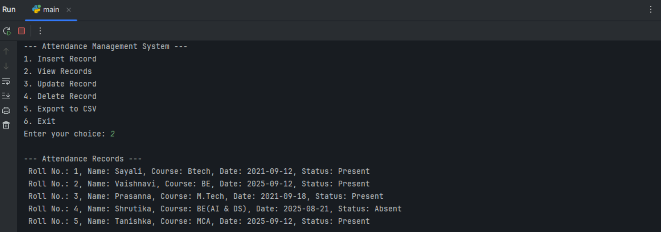
View Record

Slide 10
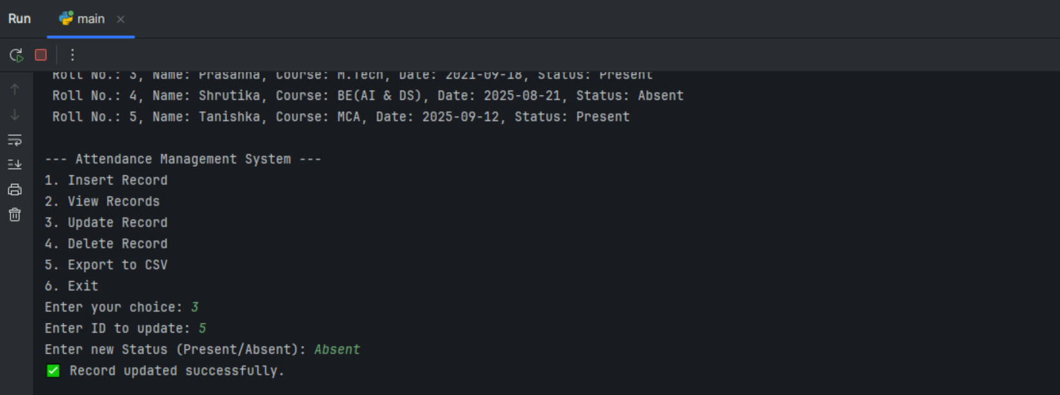
Update Record

Slide 11
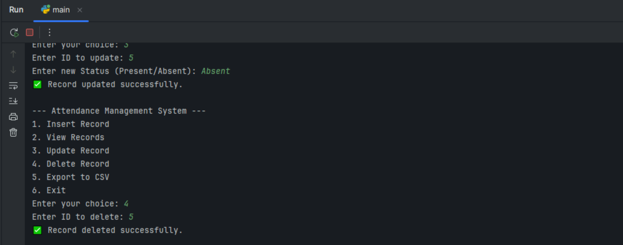
Delete record

Slide 12
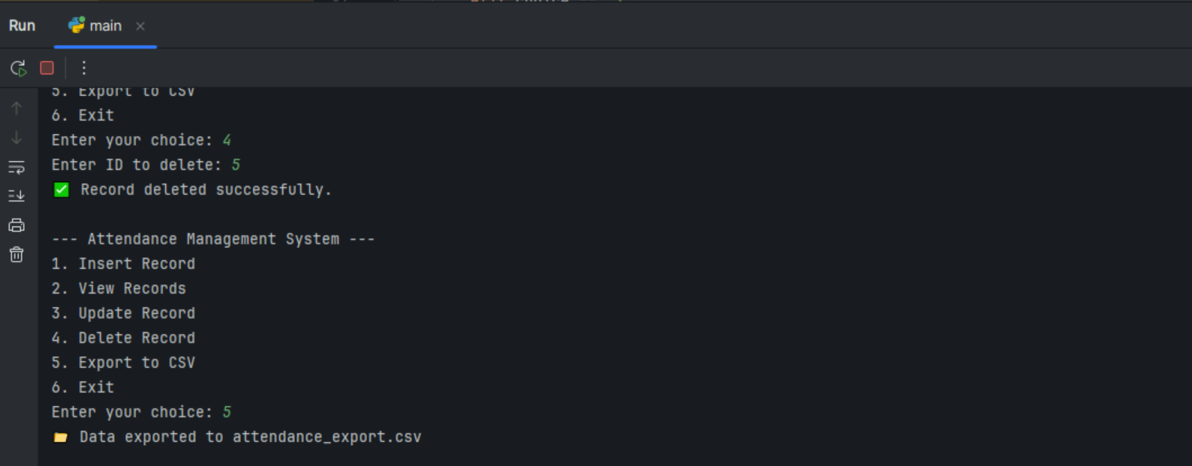
EXPORT TO CSV

Slide 13
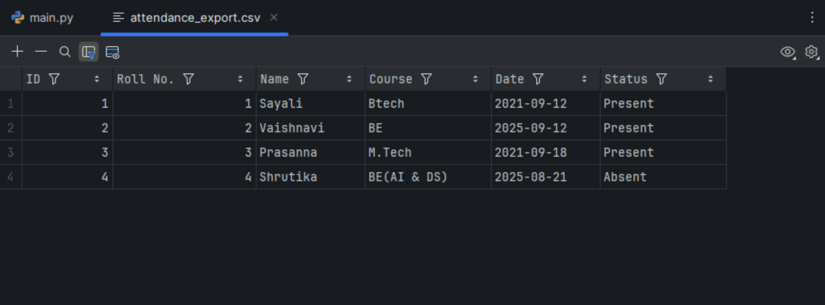
CSV file

Slide 14
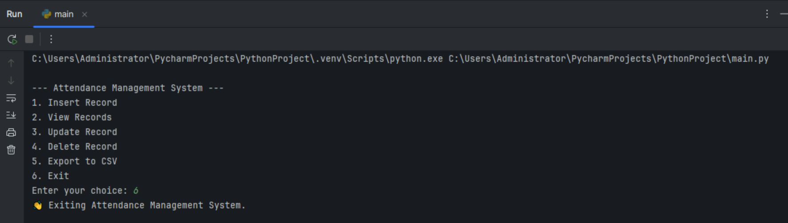
EXIT

